Slide 1
Sustainable mobility
Noora Salmela
Specialist
Circular Business Models
noora.salmela@turkuamk.fi

Slide 3
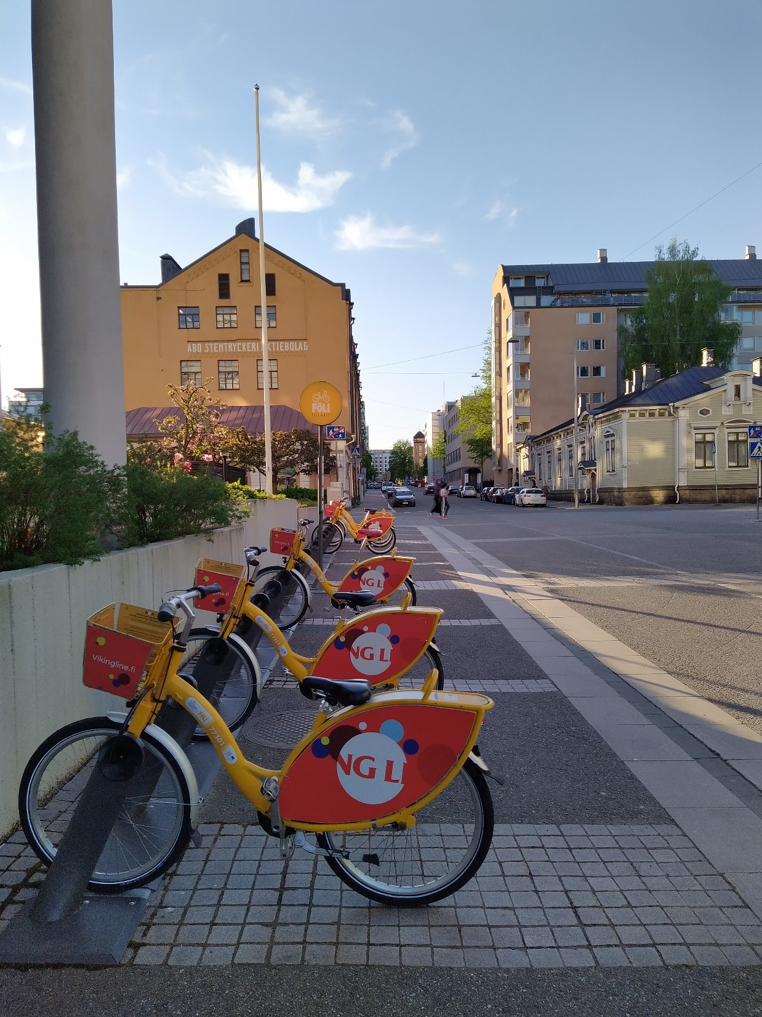
Sustainable mobility modes
Modes of mobility that are environmentally friendly
Fossil-free fuels
Less need for individual cars
Walking, cycling, public transportation, shared vehicles etc.

Slide 4
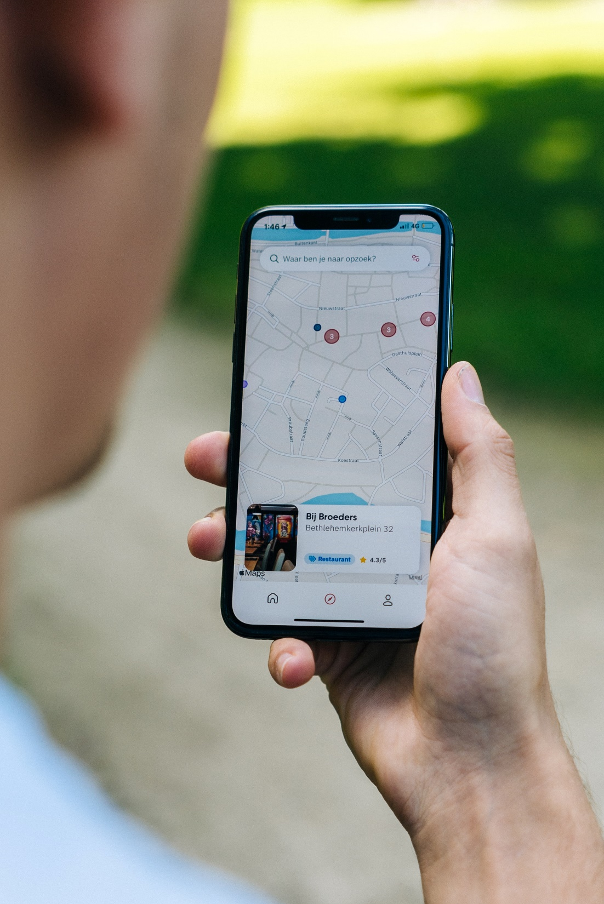
Mobility as a service (MAAS)
Planning, booking and using multiple types of sustainable mobility services
Shared use of mobility/renting insted of personaly owned vehicles
Service/digital platform that includes all the transport modes
Micromobility and last mile: from the train station to work, for instance
Mobility hubs

Slide 5
Mobility hubs
Public and shared mobility modes
May also include other services e.g. package delivery, cafeterias, repairing vehicles etc.
Central location
Pleasant space, user-friendly surroundings
In Europe: many in the UK, Germany, the Netherlands, Belgium, Norway
Smaller scale in Finland e.g. space for repairing bicycles, charging e-bikes

Slide 6
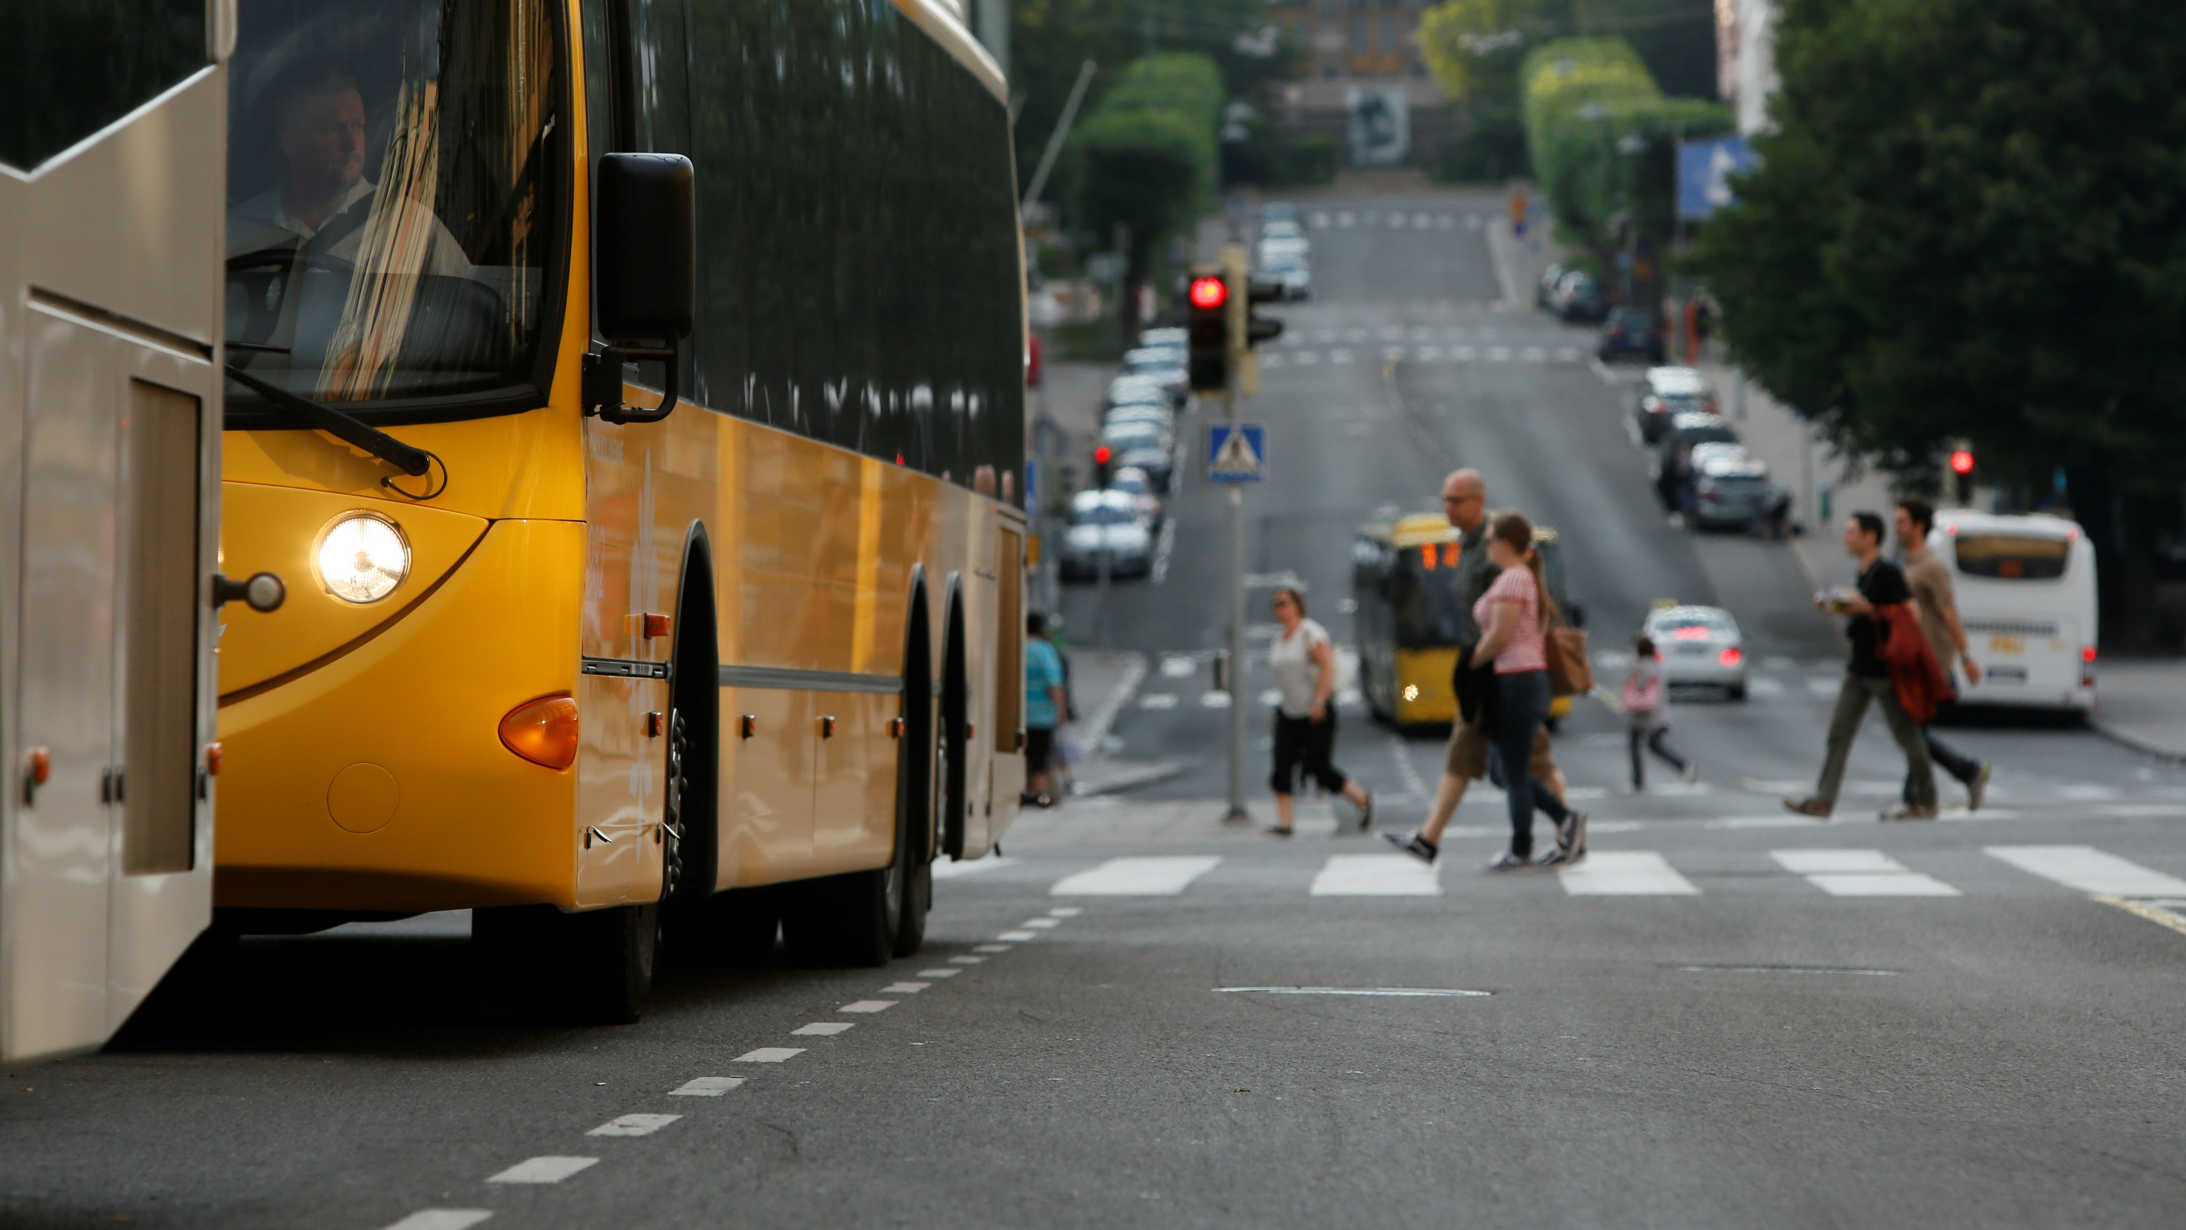
Some key points

Slide 7
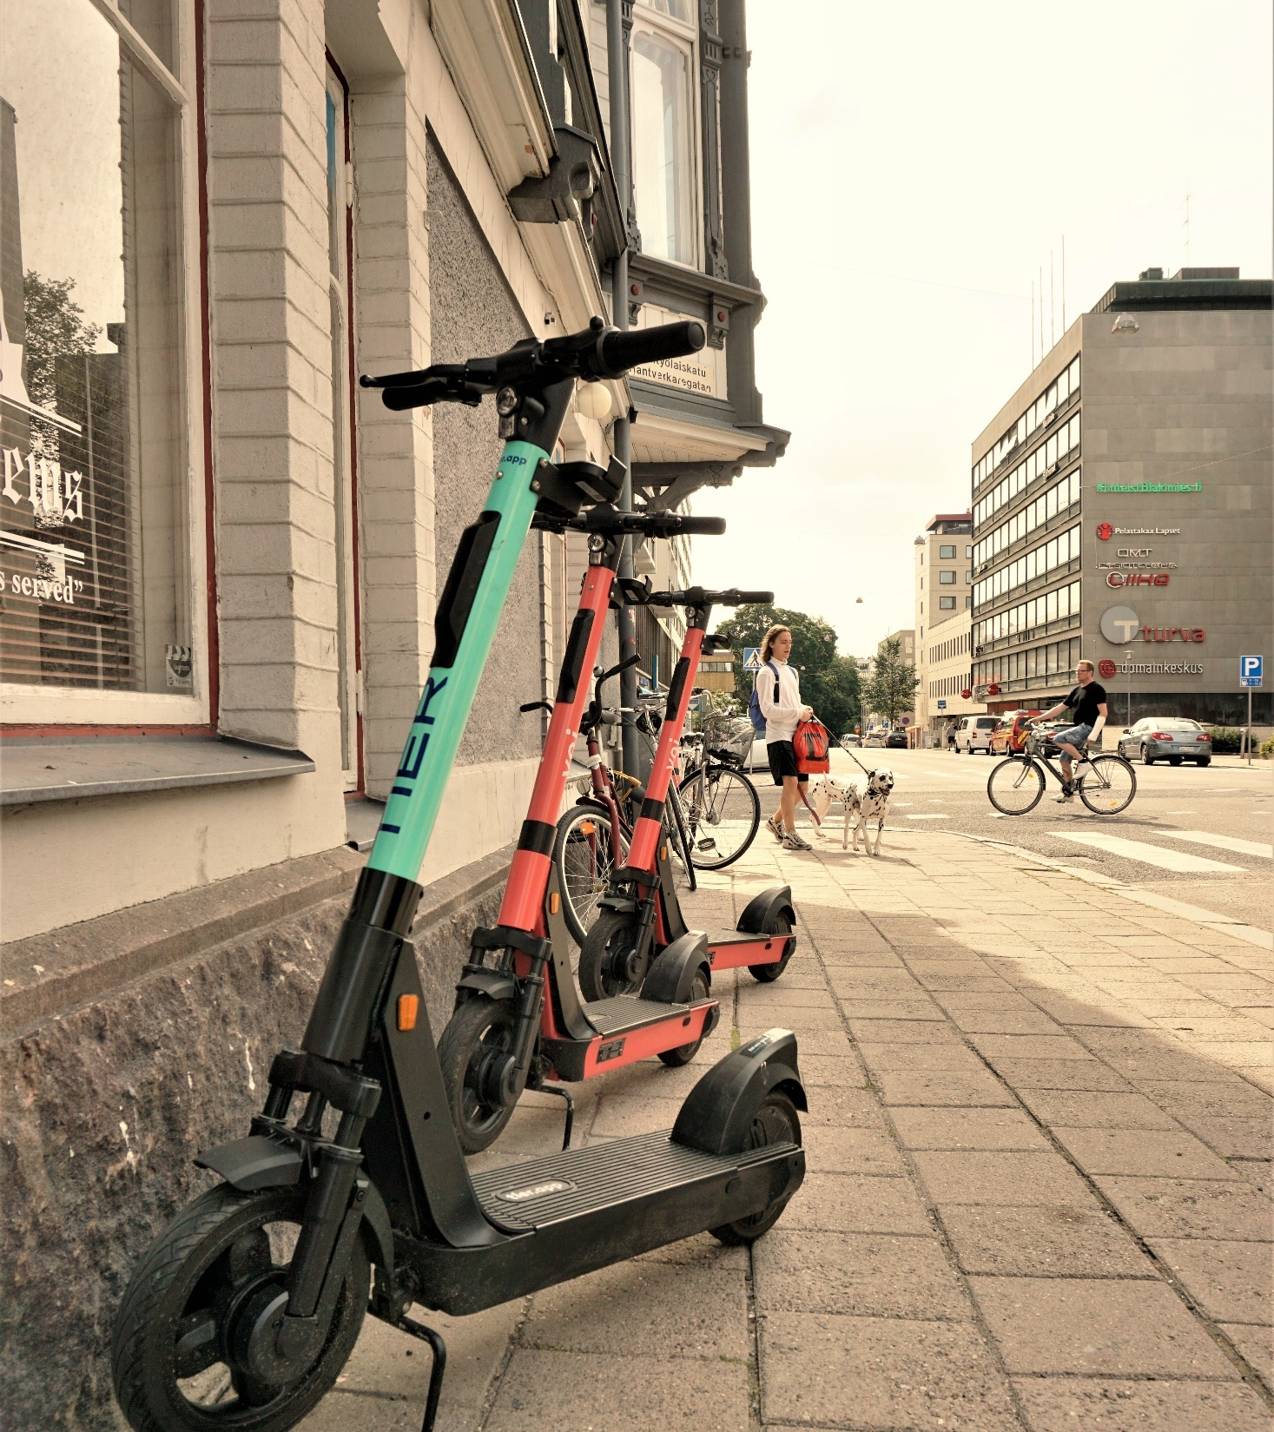
Electrification
The source of electrity is the key
Batteries: minerals and mining
Micromobility: e-scooters
Potential
Sharing over owning
Last-mile solutions that could supplement public transportation
Reality at the moment: often not environmentally-friendly
Mainly e-scooter trips replace sustainable mobility (walking, cycling and public transportation)
The source of minerals for batteries is unclear for companies
Lack of regulation in the use

Slide 8
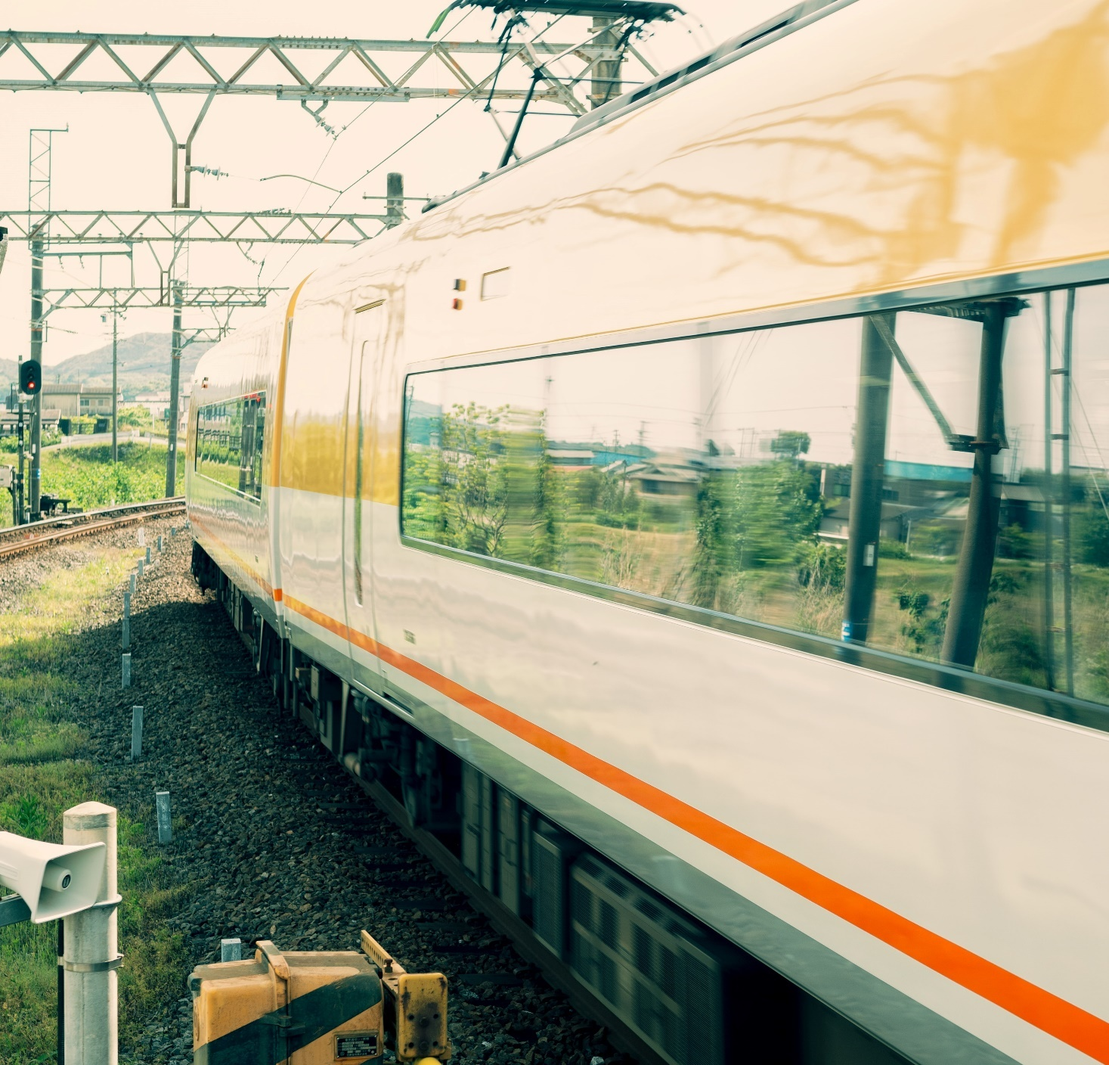
Urban/rural
Access – MAAS/mobility hubs often planned to some parts of urban cities
Urban vs. rural areas
Solutions, for example:
Demand-responsive transit
Local trains
First and last mile (micromobility)

Slide 9
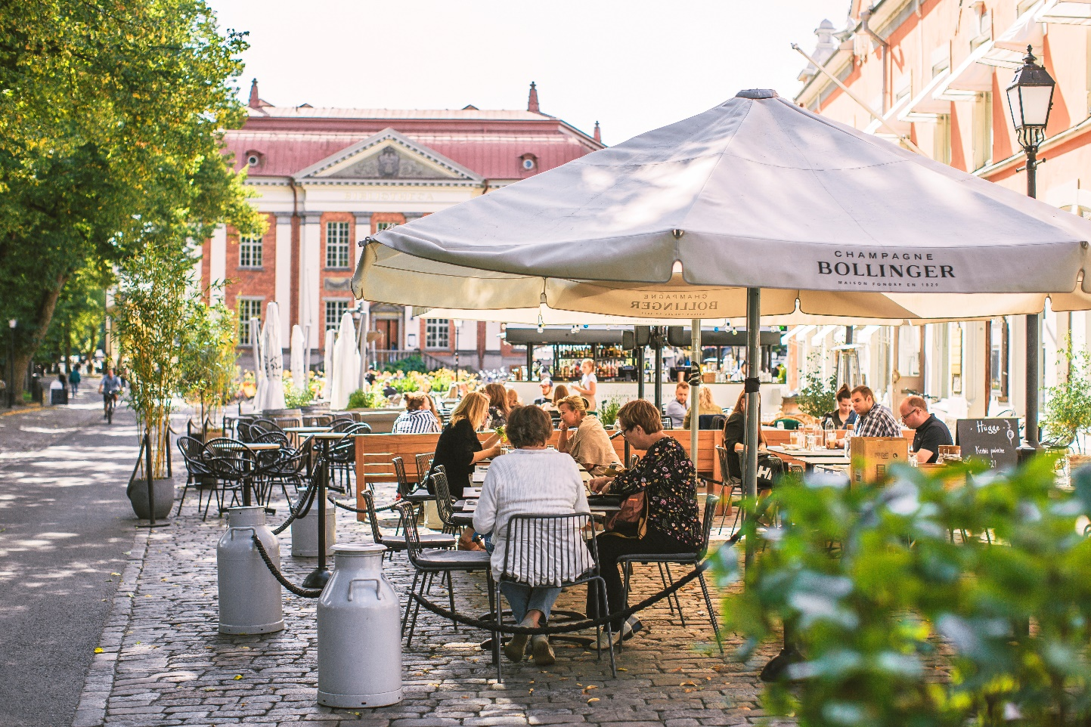
Vibrant and comfortable city
Sustainable mobility creates more space for people
Vibrant city is a place where people enjoy and like to spend time
Green spaces are important
Security: bike lanes, bike parks, walking paths, public transportation, stops etc.
-> An assett also for business

Slide 10
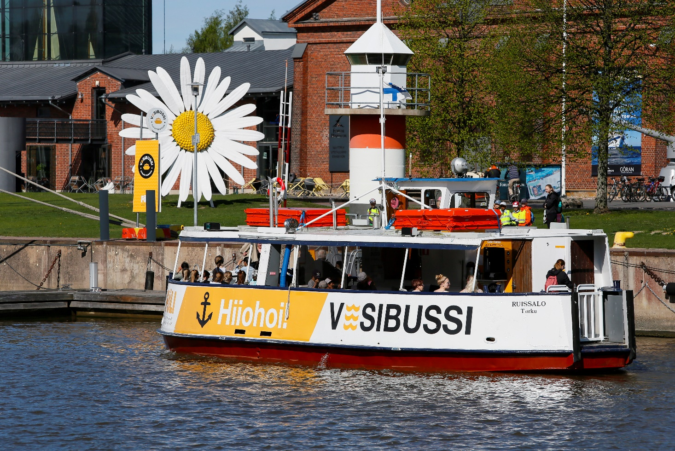
Sustainable mobility, examples from Turku
Walking streets (Yliopistonkatu, riverside, summer street in Kristiinankatu etc.)
Bike lanes, more routes made all the time
City bikes
Public transportation Föli
Water bus
Föri, Funicular
Local trains and tram?
Shared cars/city block cars?

Slide 11
Examples from your country
IN YOUR CITY,
Which sustainable mobility modes do you have?
Do you have any mobility hubs in your city/country?
Are there plans to enhance sustainable mobility in the future, how?
Look info from the internet
EXERCISE
30min
RESULTS
30min

